Slide 1



WEB SCRAPING AND EXPLORATORY DATA ON
IMDB MOVIES

Slide 2

TEAM MEMBERS:
D. L. Narasimha Rao Qualification : Master of Computer Application
PavanKumar Dadi Qualification : Bachelor of Technology (Mech)

Slide 3


Contents
Selection of website
Problem Statement
Libraries used
Data frame Creation
Data Cleaning
Descriptive Statistics
Univariant Analysis
Bivariant / Multi-variant analysis
Final Conclusion

Slide 4
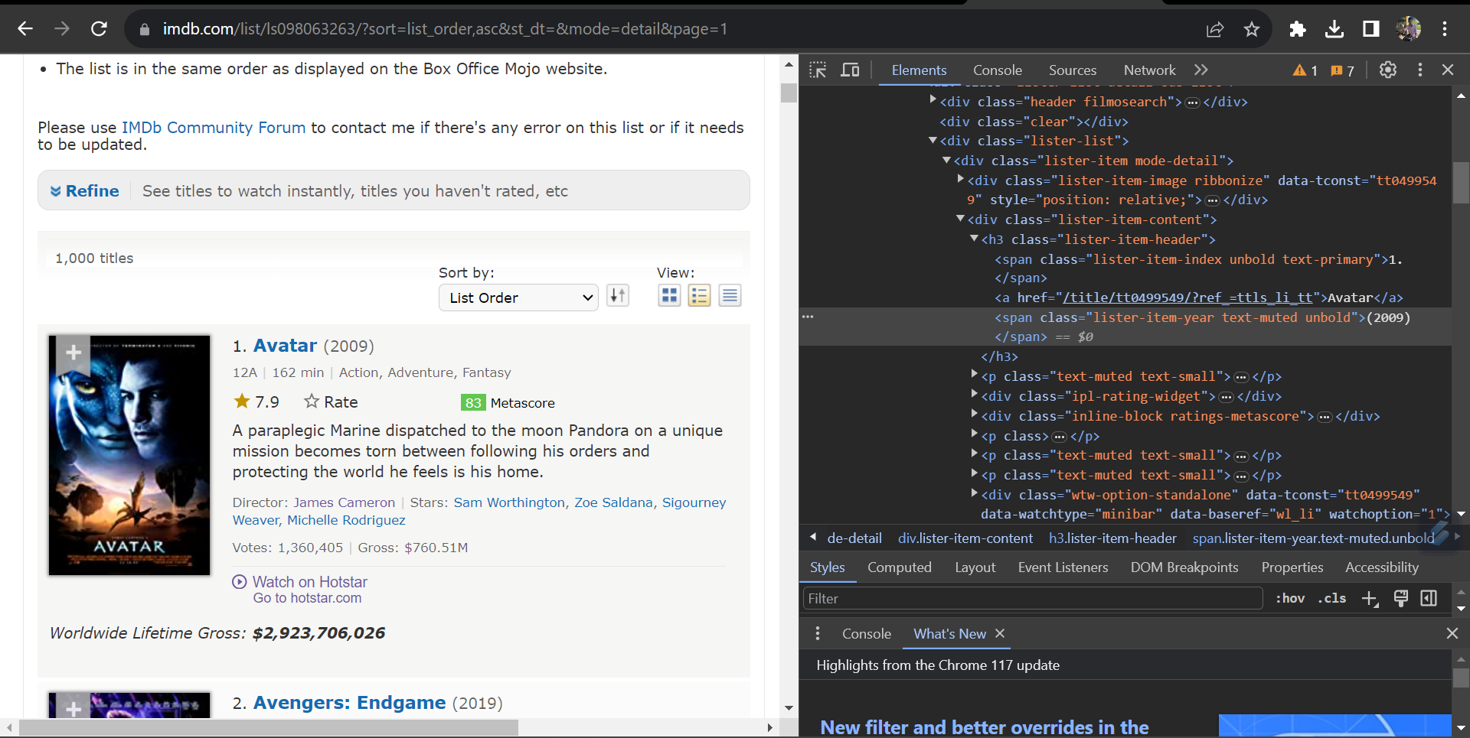
WEBSITE:
https://www.imdb.com/list/ls098063263/?sort=list_order,asc&st_dt=&mode=detail&page=1

Slide 5
PROBLEM STATEMENT
Examination of movies data to gain information in various aspects such as Rating , Genre ,Release dates.
To analyze the gross income from various Genres and also analyze how Gross will be going to increase by Yearwise.
To analyze which type of movies are peoples like most.
This analysis aims to uncover trends, patterns, and correlations within the dataset, helping filmmakers.

Slide 6

LIBRARIES USED:
NumPy
Pandas
Matplotlib
Seaborn
Requests
Beautiful Soup

Slide 7
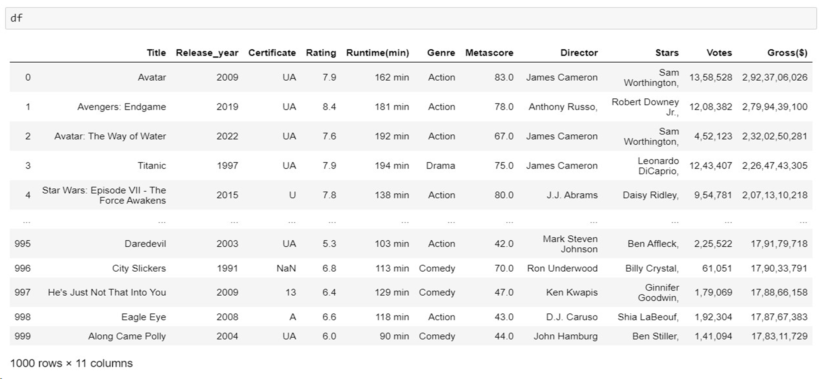
RAW DATA FRAME

Slide 8
DATA CLEANING
Identifying Null values
Identifying Missing values
Treating rows and columns with null values and missing values
Extracting required data from columns to create another columns using regular expressions
Treating columns and converting required columns from object to int or float datatype

Slide 9
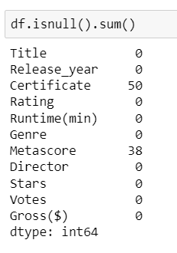
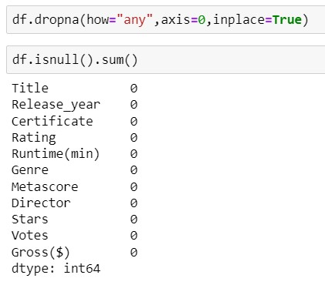




Insights:
From the data we find the null values from certificate and metascore columns.
Insights:
After finding the null values we drop rows from the data where null values exist.

Slide 10
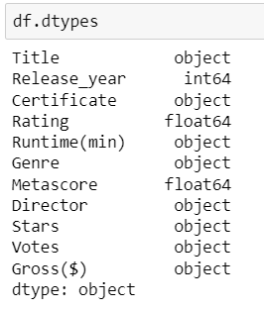
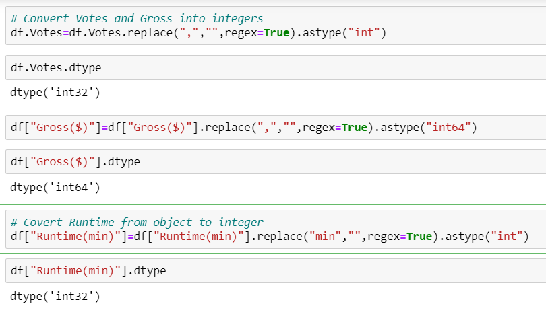



Insights:
From the beside table , Data types of data collected from websites are wrong data types .
Insights:
This code used for changing the data type of columns in data collected.

Slide 11
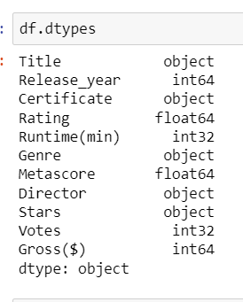
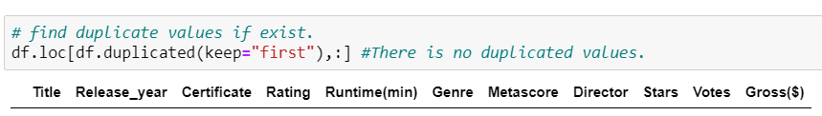



Insights:
After changing the data type of column from the data. Resultant data types of columns are presented in beside figure.
Insights:
After conversion of data types we find whether any duplicate values exist or not.

Slide 12
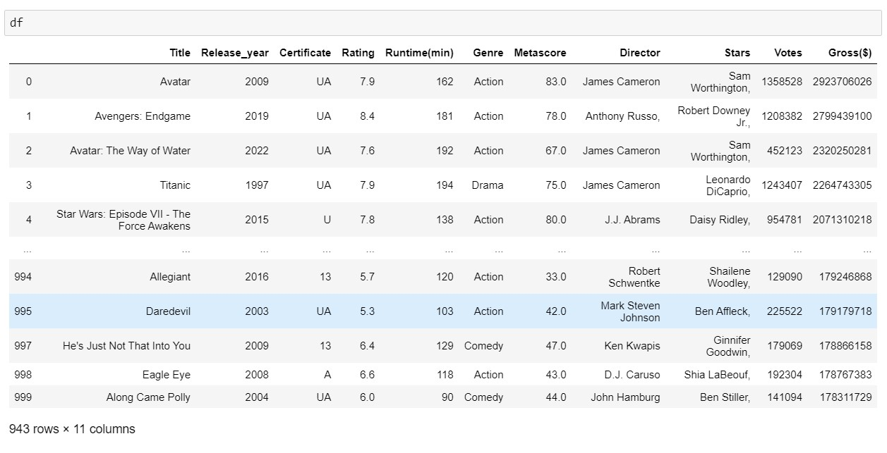
Final Data Frame:

Slide 13
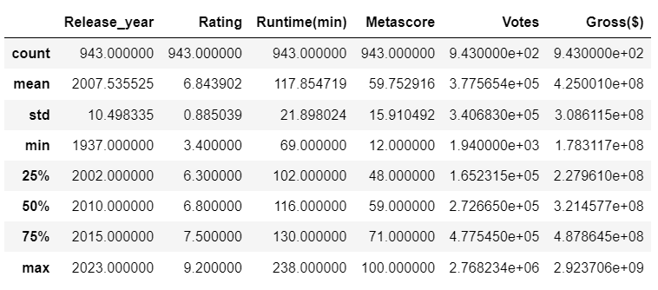
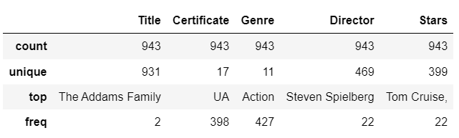
Descriptive Statistics:
Numerical data:
Categorical data:

Slide 14

DATA VISUALIZATION

Slide 15
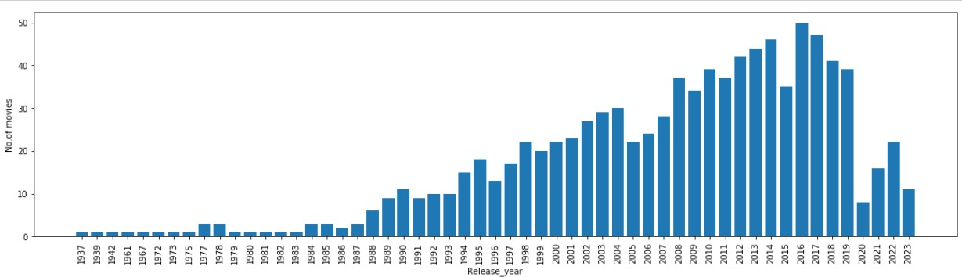
UNIVARIATE ANALYSIS
CATEGORICAL DATA
Insights:
By Examining the overall trend of movie released over the years. we are notice patterns, such as growth of movies released from the very first to since now.

Slide 16
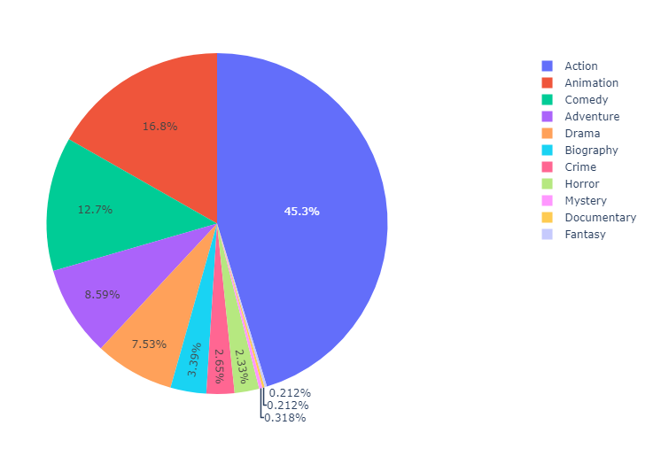
ANALYZE NO.OF MOVIES WERE RELEASED IN GENRE WISE
Insights:
The pie chart visually illustrates the distribution of movies across various genres, revealing which genre dominate the dataset and their respective proportions. This information offers valuable insights of diversity and popularity of movie genres within the dataset.

Slide 17
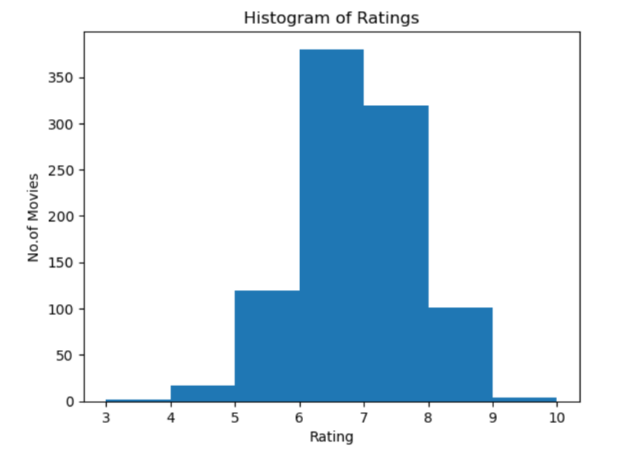
NUMERICAL DATA
DISPLAY RANGE BETWEEN RATING AND MOVIES
Insights:
The histogram reveals that the majority of movies rating fall within a specific range, suggesting a concentration of films with certain ratings, while some movies receive extreme or outlier ratings.

Slide 18
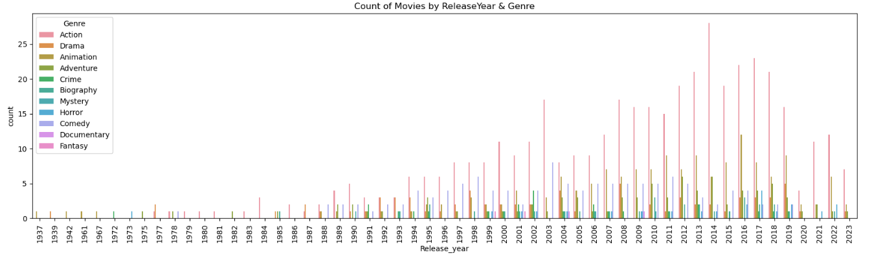
BIVARIATE ANALYSIS
CATEGORICAL DATA Vs CATEGORICAL DATA
Insights:
It shows that the number of movies released per genre over the years reveal evolving audience preferences and industry trends, offering a visual narrative , how different genres have gained S popularity throughout cinematic history.

Slide 19
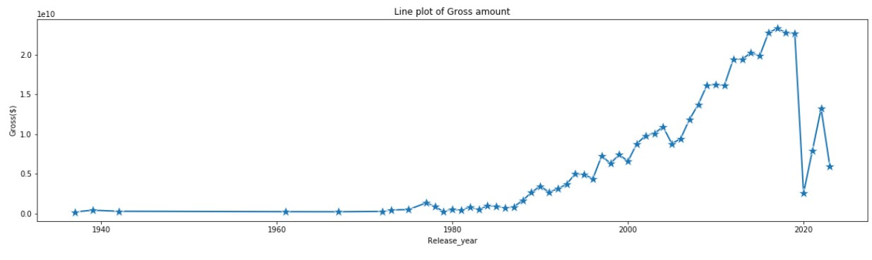
CATEGORICAL DATA Vs NUMERICAL DATA
Insights:
The line plot depicting the relationship between gross revenue and release years reveal how the film industry earnings has been evolved over time, reflecting changing audience preferences and market dynamics.

Slide 20
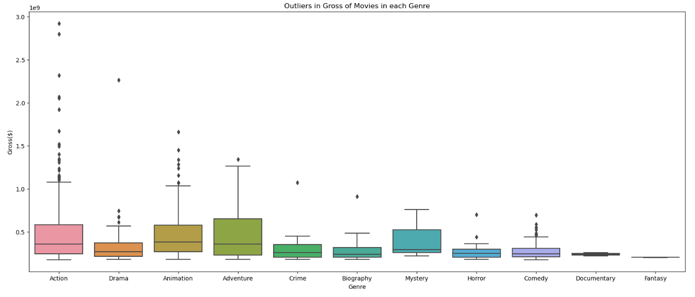
CATEGORICAL DATA Vs NUMERICAL DATA
Insights:
A box plot analysis reveals how movie genres are distributed in terms of gross revenue, providing insights into the range, median, and outliers within each genre category.

Slide 21
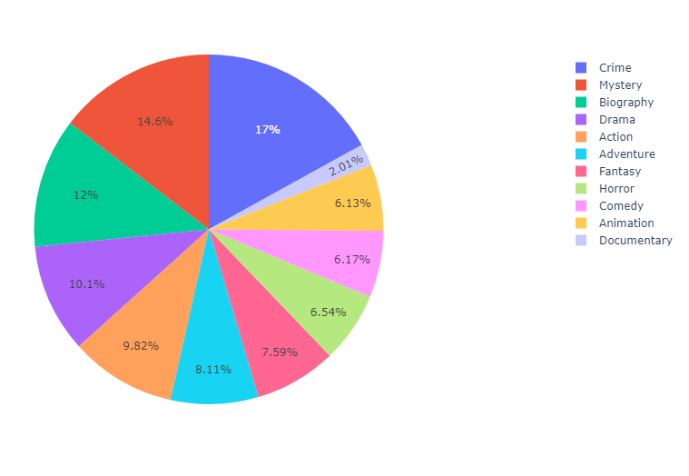
CATEGORICAL DATA Vs NUMERICAL DATA
Insights:
Exploring the relationship between movie genres and votes through a pie plot reveals the distribution of votes across different genres, shedding light on audience preferences.

Slide 22
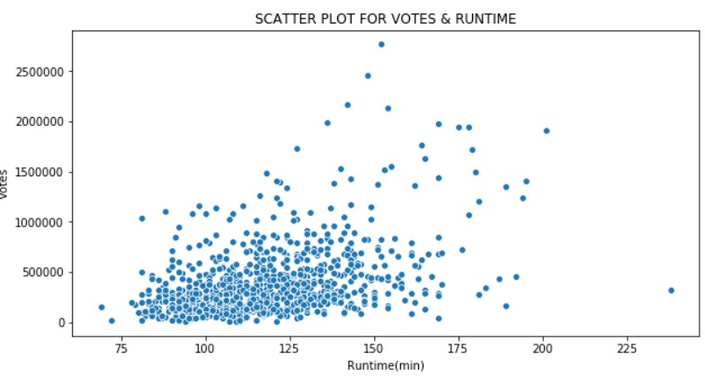
NUMERICAL DATA Vs NUMERICAL DATA
Insights:
In a scatter plot depicting movie runtime against the number of votes, it's evident that shorter runtime movies tend to attract higher number of votes, possibly due to their accessibility and wider audience appeal.

Slide 23
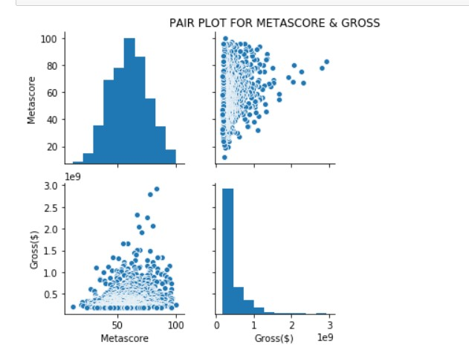
NUMERICAL DATA Vs NUMERICAL DATA
Insights:
A pair plot analysis reveals a correlation between a movie's Metascore rating and its box office gross, suggesting that audience voting preferences can influence a film's financial success.

Slide 24
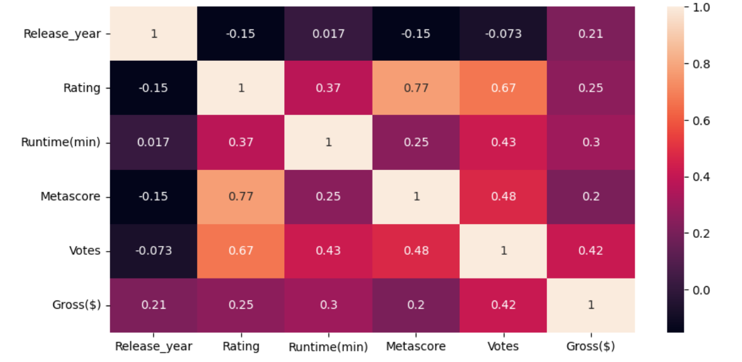
MULTIVARIATE ANALYSIS
Insights:
A heatmap visualization of a movies dataset reveals the correlations and trends between various movie attributes, offering valuable insights into factors influencing a film's success.

Slide 25
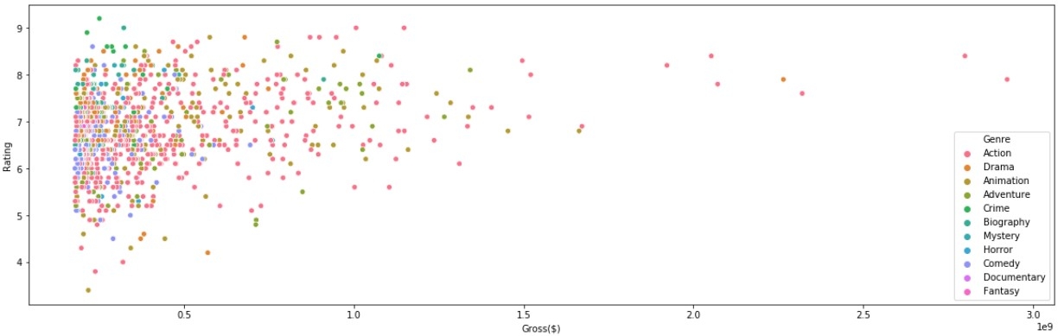
Insights:
A scatter plot comparing movie gross (on the x-axis) to its Rating (on the y-axis) reveals a diverse range of ratings across various genres. Additionally, the size of each data point correlates with the movie's gross revenue, illustrating the financial success of certain genres and their respective ratings.

Slide 26
CHALLENGES FACED:
While collecting data from the websites we had to go through each page and do separately.
Few pages has Null values and Data missing even though it is presenting web page .
We had gone through each page and checked if data is missing when extracted then it was added manually using Python.
If we had to replace more data we just done some operation on that particular column.

Slide 27
Conclusion:
We here by conclude sharing our observations in this particular project :
Here our problem statement is recommending To analyze the gross income from various Genres and also analyze how Gross will be going in Year wise.
Considering our observations we analyze that the Action Genre Movies are highest viewed by people and collect high collections than other Genres.
By this we conclude that the more number of movies had Rating between 6 to 8.
When we compare the Genre and votes we find that the most of the people vote for crime and biography genre.

Slide 28


